Slide 1


Slide 2

Banking Analytics and Credit – Debit Analytics
Meet the Team:
Sumit
Pranay
Kaviraj
Shivam
Ramjee
Gulfam

Slide 3

Objectives and Impacts
Objectives:
To analyze banking data (clients, loans, repayments, and branch transactions) to track performance and financial health.
Built SQL queries to calculate KPIs like Total Clients, Active Clients, Loan Disbursed, Repayments, and Principal Recovery Rate.
Extended analysis to transaction growth at the branch level using debit/credit records.
Provided a data-driven framework to evaluate client base, loan efficiency, repayment strength, and branch growth trends.

Slide 4

Objectives and Impacts
Impacts:
Clear visibility on new vs. active vs. lost clients helps in designing retention strategies.
Identification of delinquent and default trends improves credit risk assessment.
Automated dashboards save manual reporting time and reduce errors.
Insights on disbursement, recovery rate, and profitability guide smarter lending policies.
Branch-level comparisons highlight top-performing and underperforming regions.

Slide 5

Banking Analytics KPI INFOGRAPHICS
Total Clients – Size of customer base
Active Clients – Currently engaged borrowers
New Clients – Recently acquired customers
Total Loan Amount Disbursed – Total lending volume
Total Funded Amount – Capital deployed in loans
Average Loan Size – Typical loan per client
Total Repayment Collected – Cash inflows from repayments
Principal Recovery Rate – % of principal recovered

Slide 6
Banking Credit and Debit KPI INFOGRAPHICS
Total Credit Amount – Overall money credited into accounts Total Debit Amount – Overall money withdrawn/debited Credit to Debit Ratio – Balance between inflows and outflows
Net Transaction Amount – Difference between total credits and debits Account Activity Ratio (%) – Proportion of active account usage
Transactions per Day/Week/Month – Frequency of customer transactions over time
Total Transaction Amount by Branch – Branch-wise distribution of transaction value

Slide 7

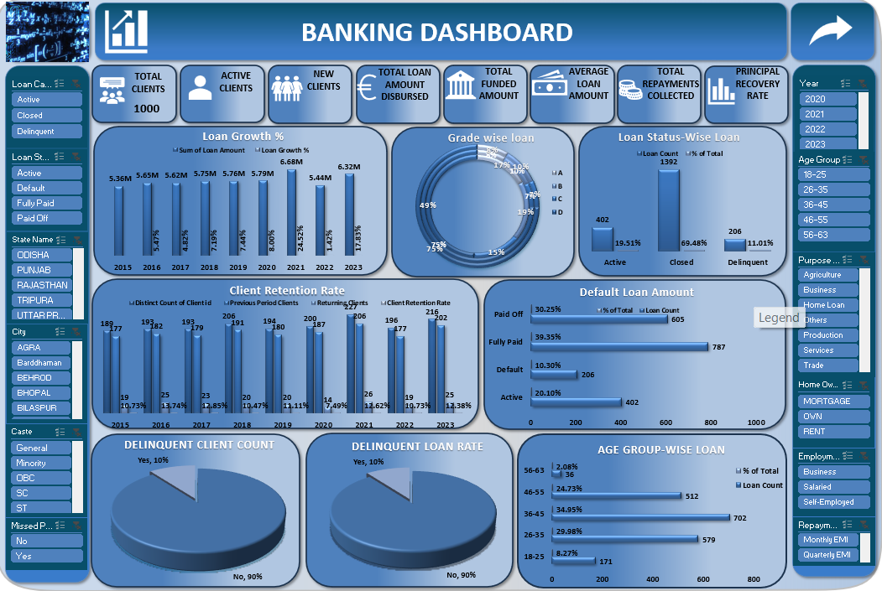
EXCEL DASHBOARD 1

Slide 8
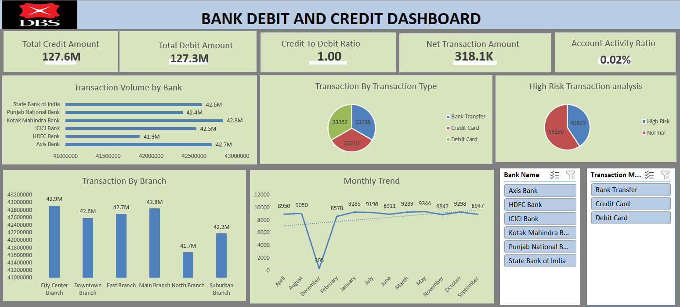
EXCEL DASHBOARD 2

Slide 9

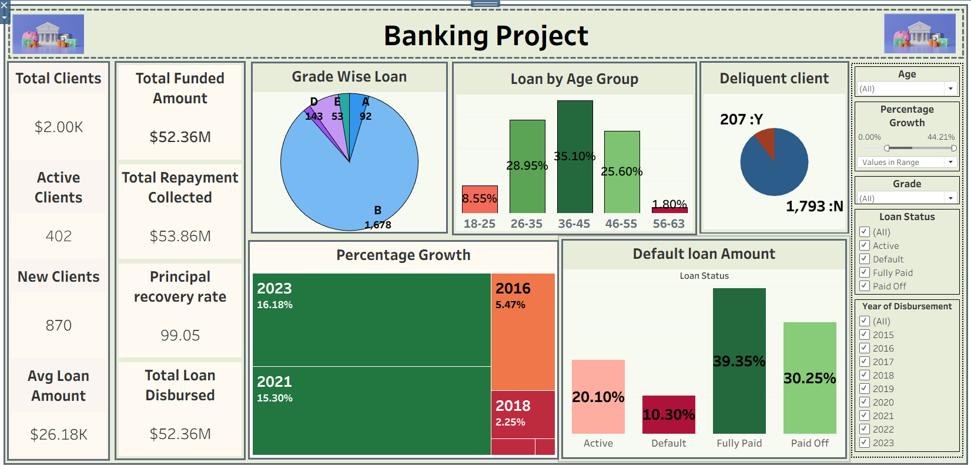
TABLEAU DASHBOARD 1

Slide 10
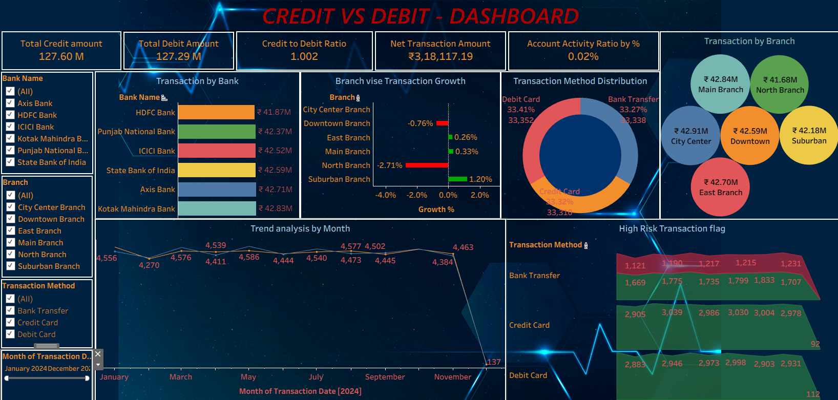
TABLEAU DASHBOARD 2

Slide 11

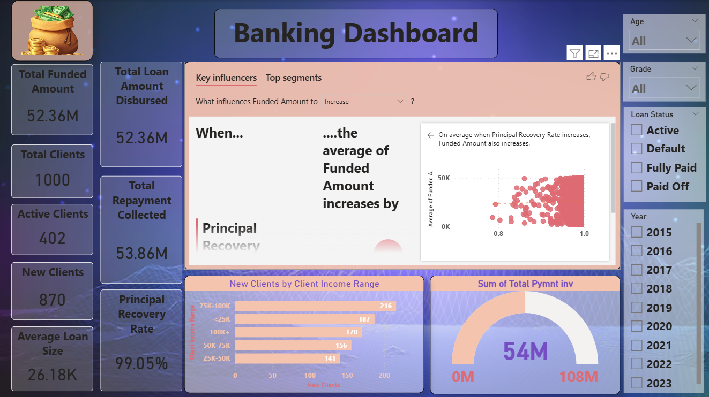
POWER BI DASHBOARD 1

Slide 12
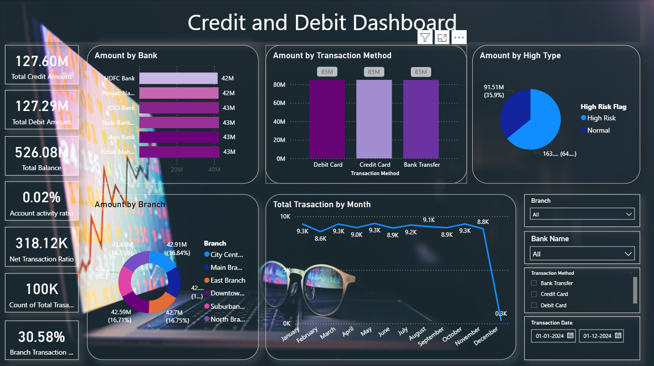
POWER BI DASHBOARD 2

Slide 13

Analytical Highlights
Steady growth in total clients and new clients acquisition.
Increasing loan disbursements and repayment collections → indicates trust in lending process.
High principal recovery rate shows strong repayment discipline.
Balanced credit vs debit transactions → indicates healthy cash flow.
Branch-level data highlights regional performance differences.

Slide 14

Bottlenecks
Inactive clients lowering account activity ratio
Some branches underperforming compared to others
Default or delayed repayments still impacting revenue
Limited digital engagement among certain customer segments
Need for better fraud detection & risk management

Slide 15

Strategic Suggestions
Strengthen customer engagement programs to activate dormant clients
Offer personalized loan products based on transaction/repayment history
Increase digital adoption via mobile & online banking campaigns
Enhance branch-level monitoring with real-time dashboards
Implement AI/ML-driven risk analysis to reduce defaults
Regular customer feedback surveys to improve satisfaction

Slide 16


